Slide 1


IFN646 - BIOMEDICAL
PREDICTING COVID-19 STATUS FROM CHEST X-RAY IMAGES
Teaching Team: Dr Dimitri Perrin - Jake Bradford
GROUP 15: nhung Nguyen – an ngo - Long Nguyen
Notes:
Good evening everyone, welcome to group 15’s presentation about predicting covid 19 status from chest X-ray images
Thank you teaching team Doctor Dimitri Perrin and Jake Bradford joining with us today
Our groups has 3 members includes Nhung Nguyen, An Ngo and Long Nguyen

Slide 2

COVID-19
December 2019, a virus known as “2019 novel corona-virus” or “Severe Acute Respiratory Syndrome Coronavirus 2 (SARS-CoV-2)”
Found and spread out from Wuhan, China.
Infectious disease is called COVID-19
Image: Corona Virus (Chakisatelier, 2020)

Slide 3
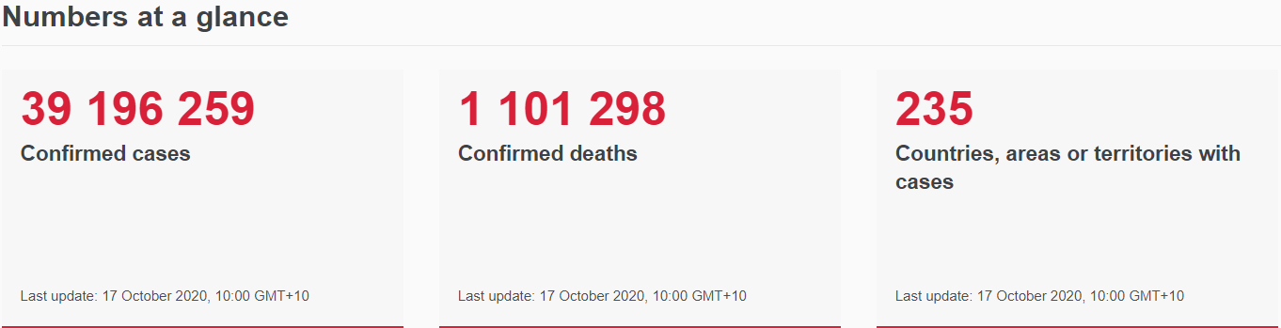

WORLD STATUS
Table: Figures of Corona cases (WHO, 202)
Early symptom diagnosing is really important so far
Lack of specific treatment and vaccine
Self-isolate the suspected people
Image: Stay Home (FDS, 2020)

Slide 4
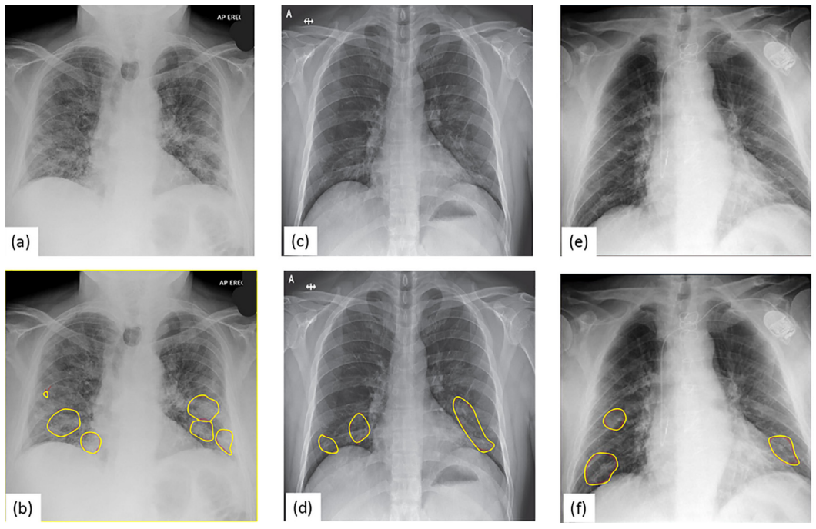
DETECTING COVID
Currently, Reverse Transcriptase – Polymerase Chain Reaction (RT-PCR) has applied
Pros: highly correctly percentage of testing result
Cons: take time to collect final result
In terms of chest radiography, X-Ray imaging is easy to apply and fast diagnosis for pneumonia
The symptoms of COVID-19 are reported to be as following:
Ground-glass and mixed attenuation (Minaee et al., 2020)
Asymmetric patchy or diffuse airspace opacities
(Rodrigues et al., 2020)
Image: Three COVID-19 images sample (Minaee et al., 2020)

Slide 5
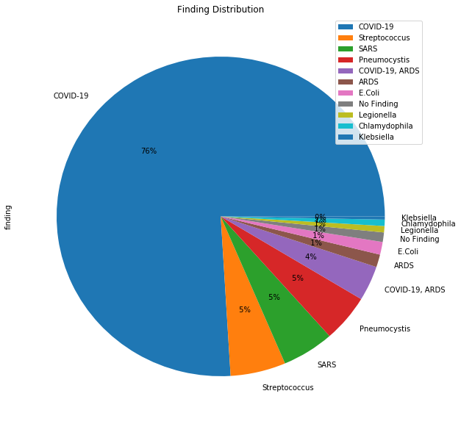
DATA VISUALIZATION AND PRE-PROCESSING

Slide 6
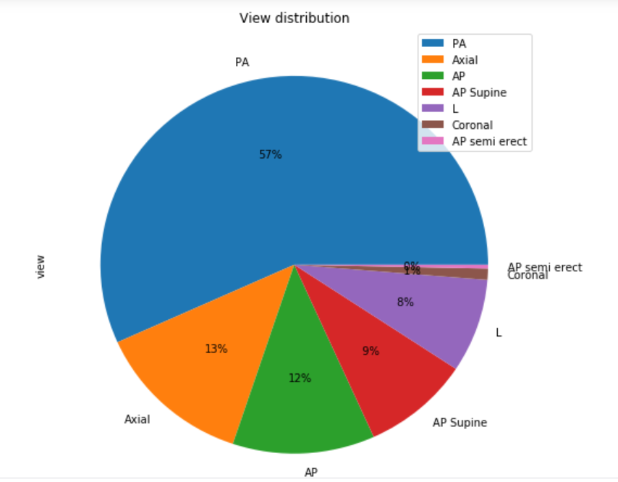
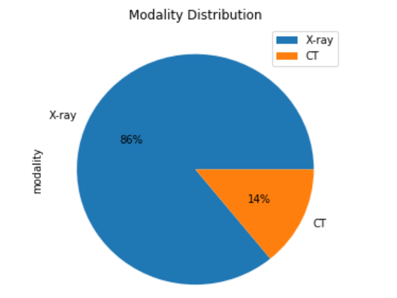
DATA VISUALIZATION AND PRE-PROCESSING

Slide 7
DATA VISUALIZATION AND PRE-PROCESSING
Dataset | Overview | Covid-19 |  | Further Approach
 |  | Positive | Negative
Actualmed-COVID-chestxray-dataset | Raw images: 238 PA view: 188 | 32 | 156 | No
COVID-19 Radiography Database | Labeled image: 1560 | 219 | 1341 | TrainData
covid-chestxray-dataset | Raw images: 930 PA view: 338 | 180 | 158 | TestData
Figure1-COVID-chestxray-dataset | Raw images: 55 PA view: 3 | 2 | 1 | No

Slide 8
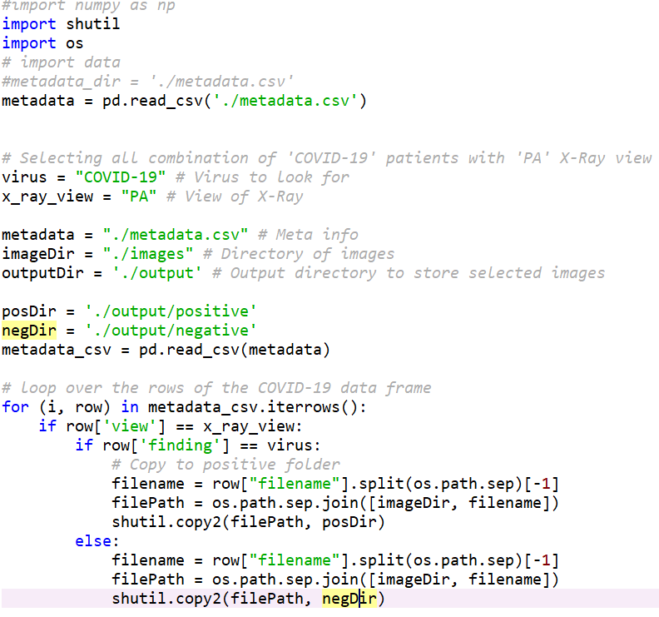
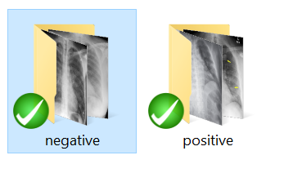
DATA VISUALIZATION AND PRE-PROCESSING

Slide 9
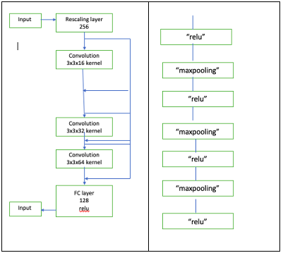
The proposed framework
Tensorflow Keras
CNN

Slide 10
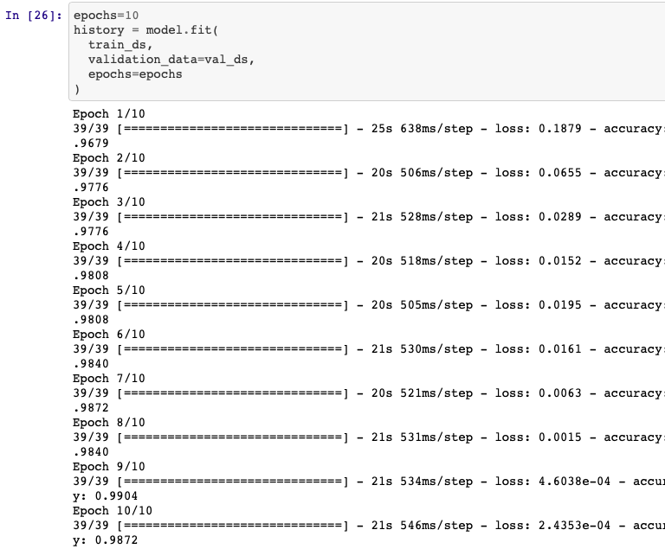
The proposed framework
Covid-19 Radiography Dataset

Slide 11
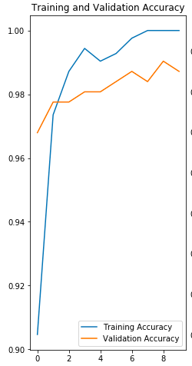
The proposed framework
Covid-19 Radiography Dataset

Slide 12
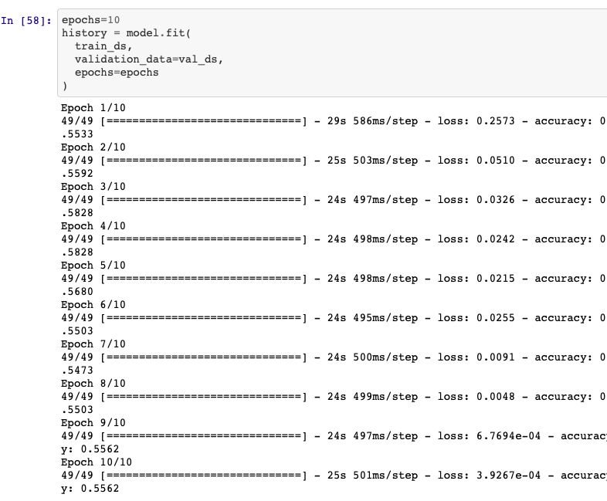
The proposed framework
Covid-19 Chest Xray Dataset
Covid-19 Radiography Dataset

Slide 13
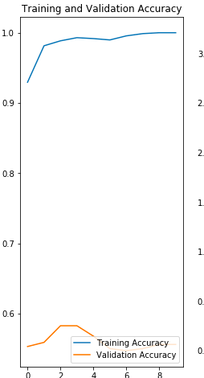
The proposed framework
Covid-19 Chest Xray Dataset
Covid-19 Radiography Dataset

Slide 14
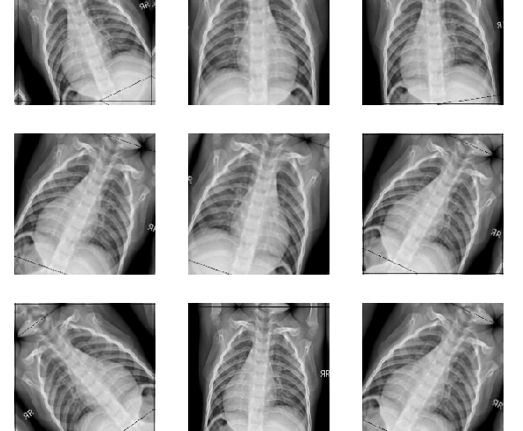
The proposed framework
Data augmentation

Slide 15
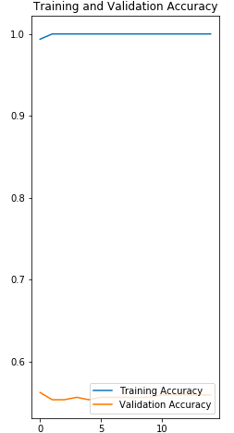
The proposed framework
Data augmentation

Slide 16
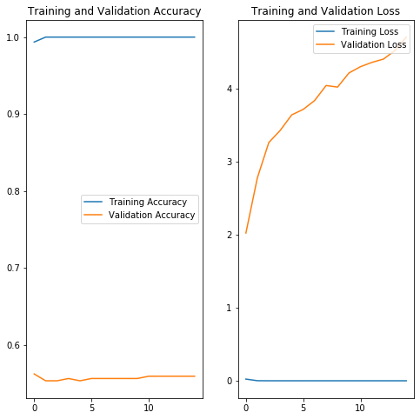

CONCLUSION AND DISCUSSION

Slide 17
REFERENCES
Chakisatelier. (2020). Coronavirus disease COVID-19 infection medical with typography and copy space. New official name for Coronavirus disease named COVID-19, pandemic risk background vector illustration. https://stock.adobe.com/au/images/coronavirus-disease-covid-19-infection-medical-with-typography-and-copy-space-new-official-name-for-coronavirus-disease-named-covid-19-pandemic-risk-background-vector-illustration/332191671/
WHO. (2020). Coronavirus disease (COVID-19) pandemic. https://www.who.int/emergencies/diseases/novel-coronavirus-2019
FDS. (2020). Coping with self-isolation. https://www.fds.org.au/messageboard/coping-with-self-isolation
Minaee, S., Kafieh, R., Sonka, M., Yazdani, S., & Jamalipour Soufi, G. (2020). Deep-COVID: Predicting COVID-19 from chest X-ray images using deep transfer learning. Medical image analysis, 65. https://doi.org/10.1016/j.media.2020.101794
Rodrigues, J. C. L., Hare, S. S., Edey, A., Devaraj, A., Jacob, J., Johnstone, A., McStay, R., Nair, A., & Robinson, G. (2020). An update on COVID-19 for the radiologist - A British society of Thoracic Imaging statement. Clinical radiology, 75(5), 323-325. https://doi.org/10.1016/j.crad.2020.03.003

